Slide 1




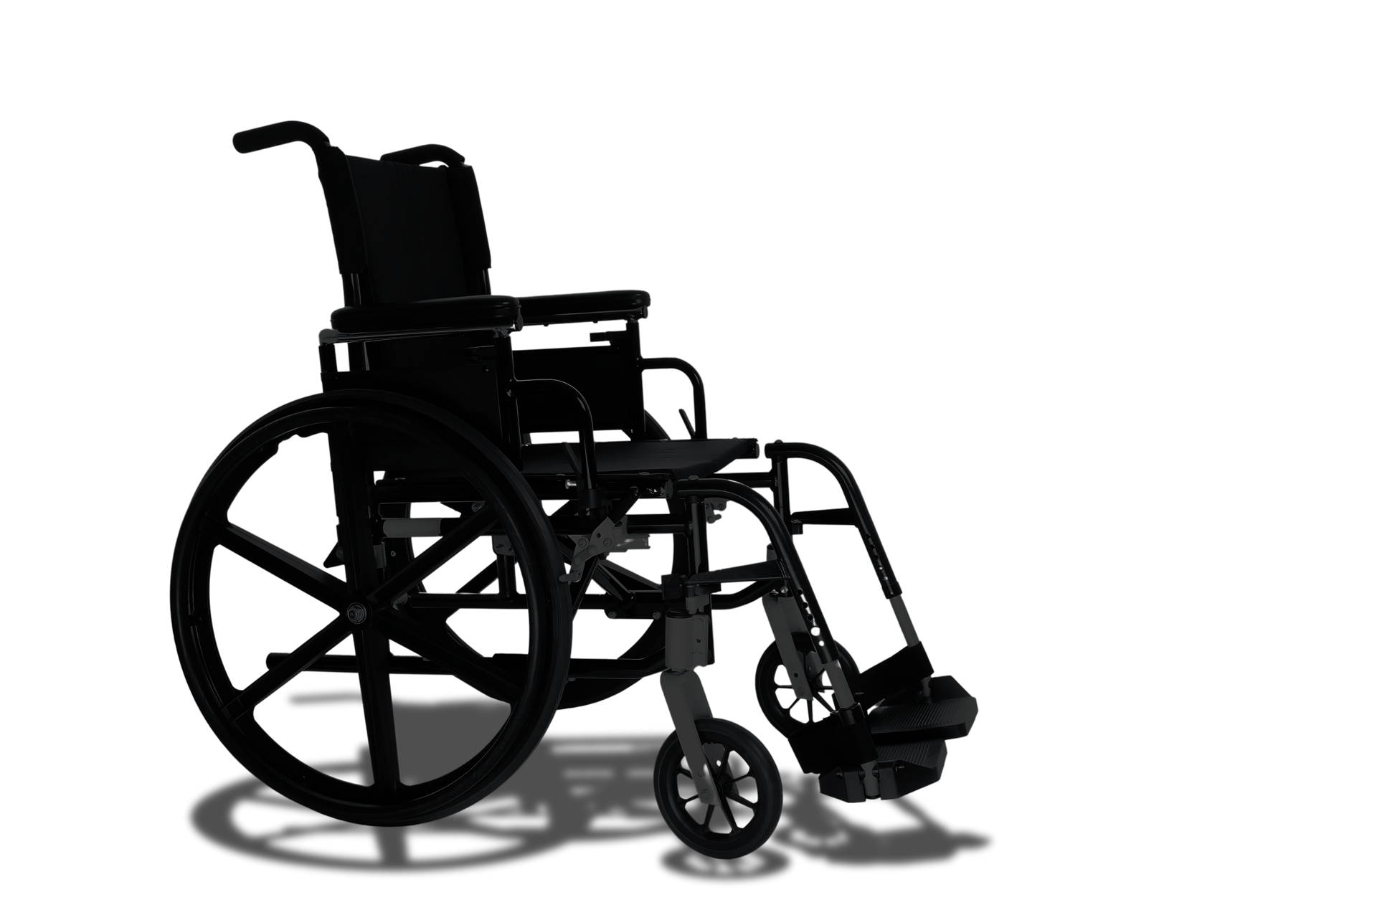

A Mind Controlled and User-Centered intelligent wheelchair
2024 / 2025
Mechatronics Engineering program CHS

Slide 2


A Mind Controlled and User-Centered intelligent wheelchair
2024 / 2025
Mechatronics Engineering program CHS
Team Members:
Yara Ahmed Maher
Omar Mohamed Farouq Azab
Ali Yasser Ali El-Nady
Maria Fady Fayek Nagib
Hassan Yasser Hassan
Ammar Yasser Abdelhafez
Salma Nabil Mohamed
Ahmed Ayman Ibrahem
Adham Ebrahem Abdelmonem
Zeyad Ahmed Abdelmonsef
Adham Abd-Elfatah mohamed
Under Supervision of:
Prof.Dr/Mohamed Ali ELsayed Agwa
Dr/Osama Talaat Elghonimy

Slide 3

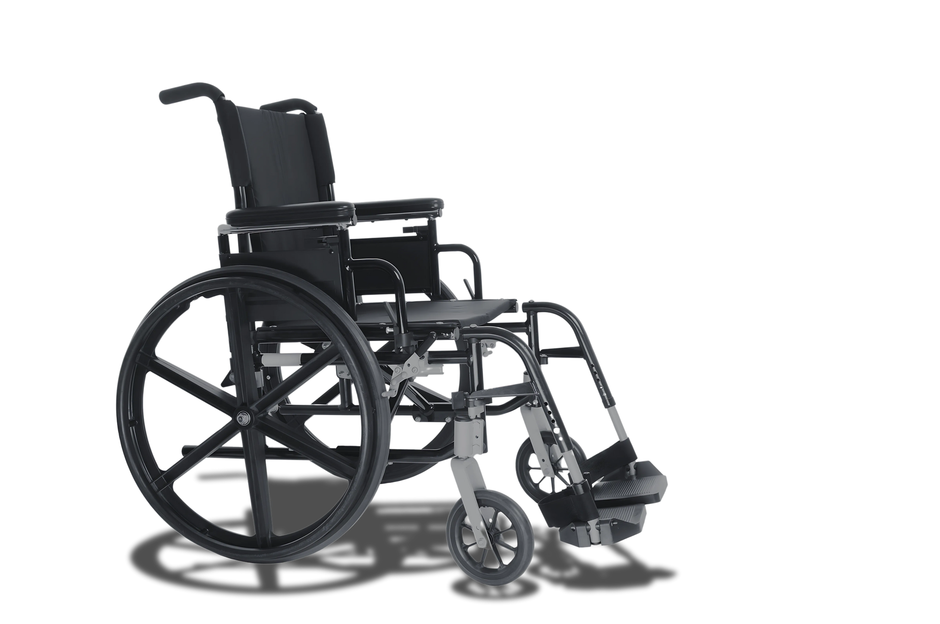











Table of Contents
Introduction
Mechanical
Electrical
Future Work
Conclusion
Testing
Programing

Slide 4
Abstract
This project presents a practical and innovative solution in assistive technology to improve mobility for individuals with severe physical disabilities. It features a brain-controlled wheelchair that interprets brain signals to control direction.
A simple, real-time algorithm processes brainwave data without using machine learning, making the system easy to use and highly responsive. The developed system successfully controls wheelchair movement and includes ADAS support. This work sets the stage for future enhancements.

Slide 5
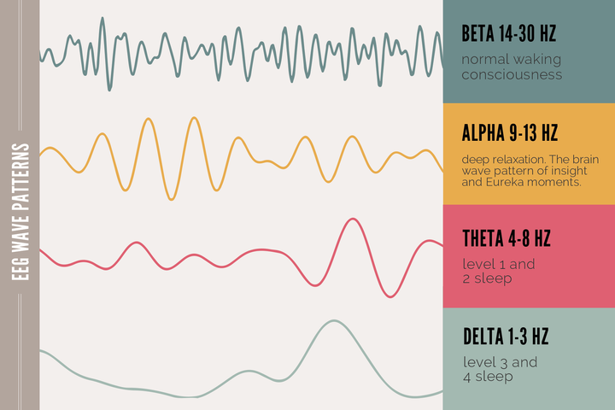
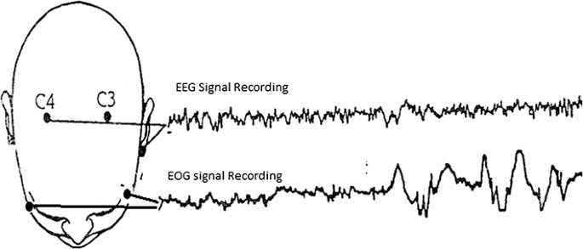
Introduction
Throughout the design phase, a wide range of brain-based control options were explored but The decision-making process involved careful consideration of signal stability, user comfort, and real-time feasibility such as :
1-Alpha, Beta, Delta and Theta rhythms .
2- Muscular responses eye movements and jaw clenching .

Slide 6
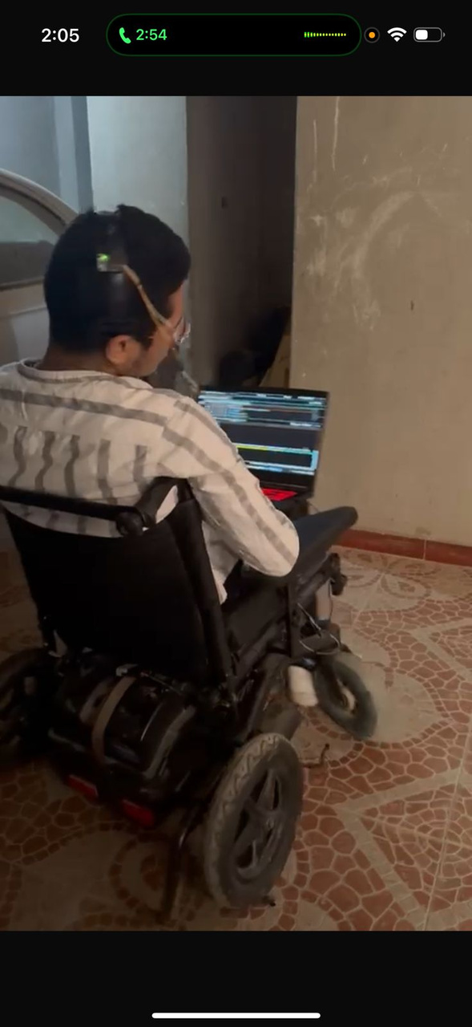
1-Process Motivation:
Their needs shaped every decision Simplicity, confidence, and ease of use were our top priorities ,So:
Brain-Computer Interface (BCI) technologies have emerged as a promising solution, allowing users to control devices using only brain activity. it becomes possible to translate neural activity into real-world commands.
This intelligent wheelchair places the user's needs at the center of its functionality. The system is designed to:
Provide hands-free control of wheelchair direction .

Slide 7
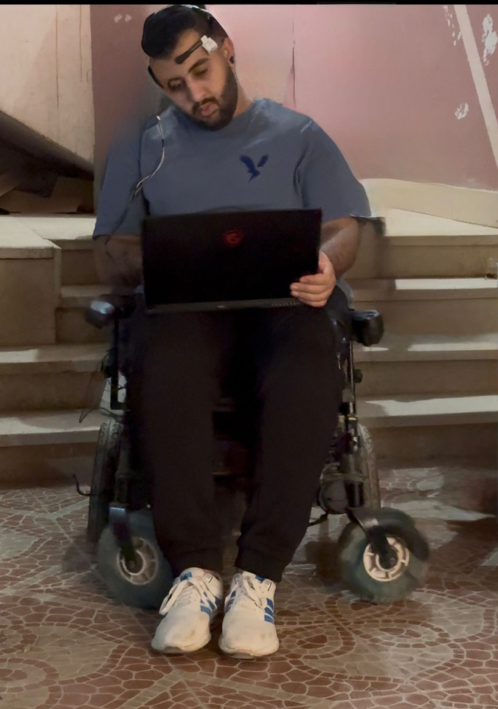
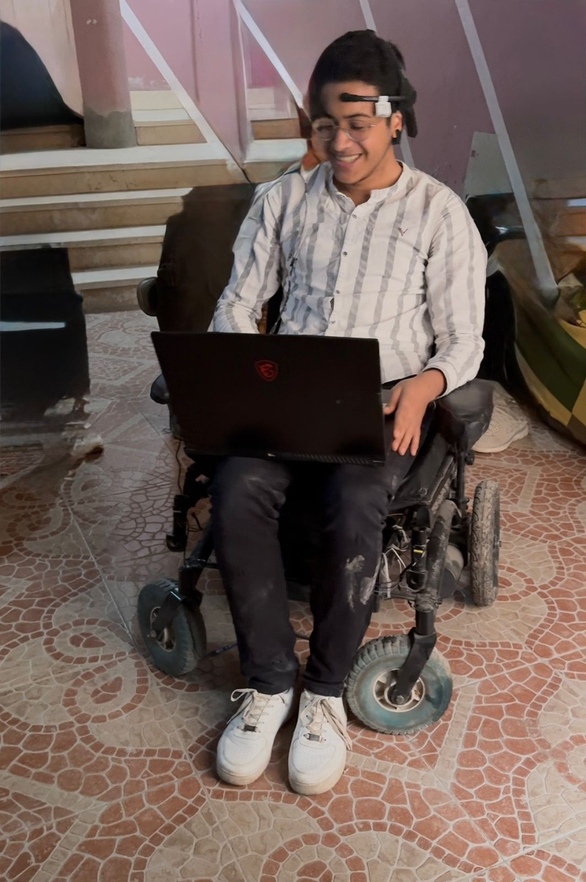
2-Accessibility Without Personalization:
Key advantage of the system is that it does not require training or user-specific calibration, unlike machine learning-based approaches which depend heavily on personalized data. It increases accessibility and makes the solution more practical .
7

Slide 8
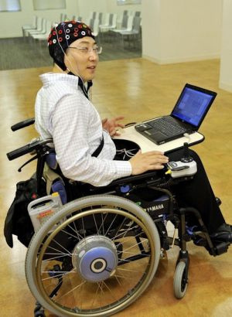
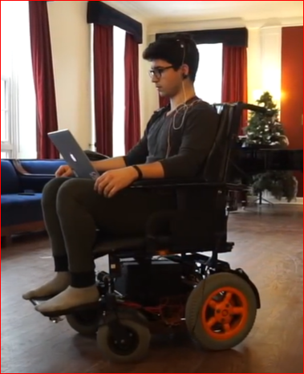
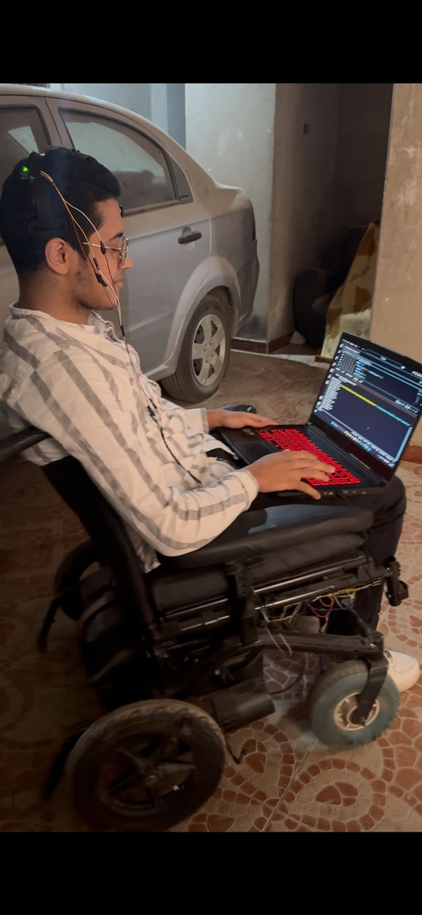
3-Proof of Concept and Practicality:
This project was developed as a fully functional and integrated system, not just a prototype or conceptual model it took from previous projects and went further with inclusion of additional safety layers.
USC
Milo
Us

Slide 9
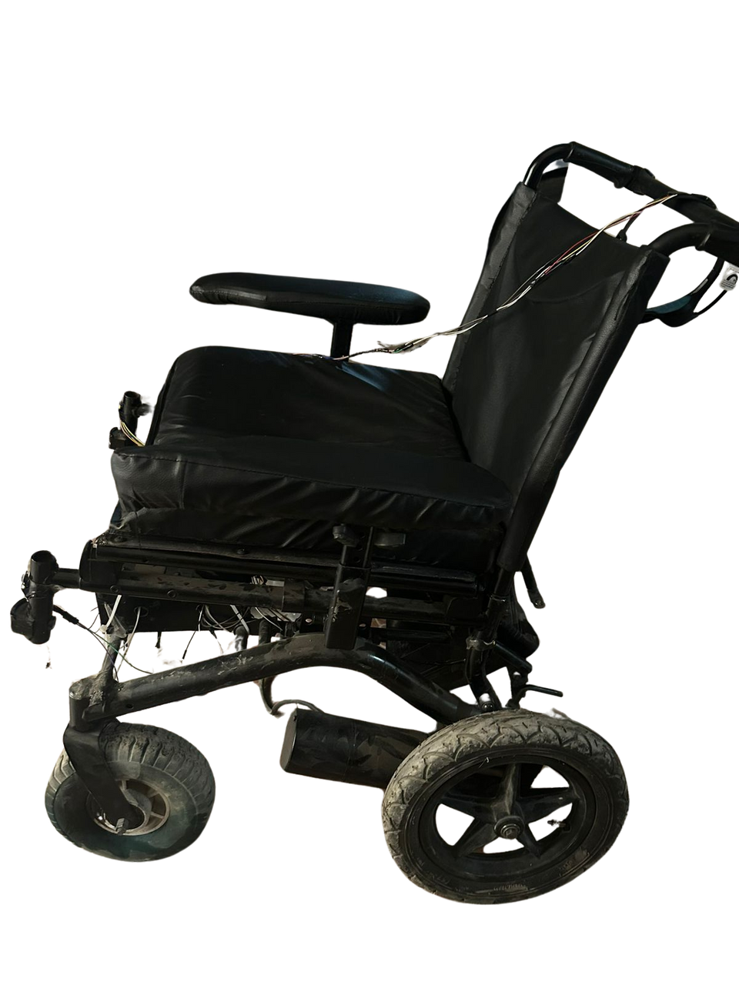
MECHANICAL DESIGN
Overview of the mechanical design of the smart wheelchair.
Key role in enhancing comfort and performance.
Challenges in achieving balance and smooth movement.
Transition from simulation to real-world application.
9

Slide 10
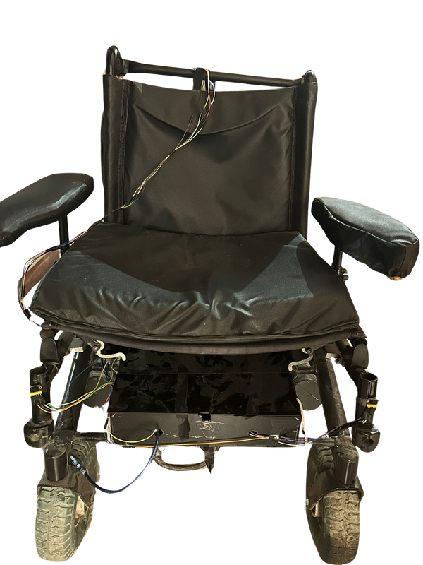
MECHANICAL DESIGN
Importance of the Mechanical
Enhances comfort and performance.
Quick responsiveness to brainwave signals.
Integration with other systems.
10

Slide 11
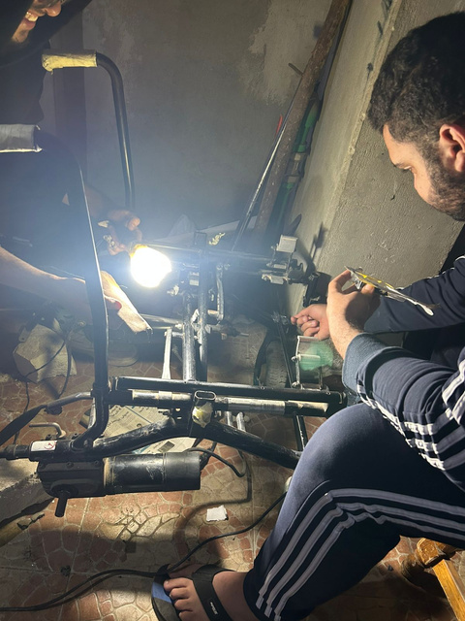
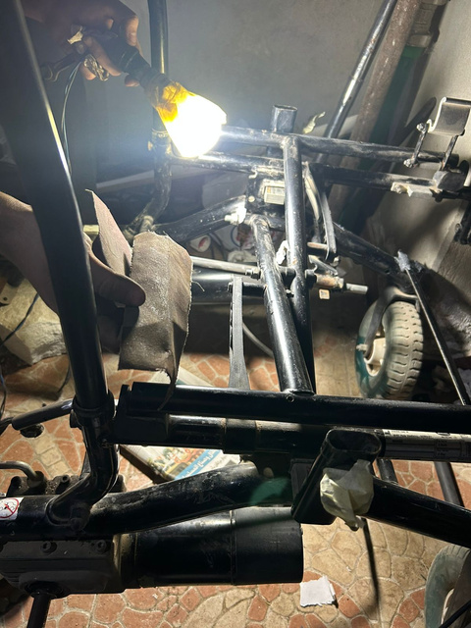
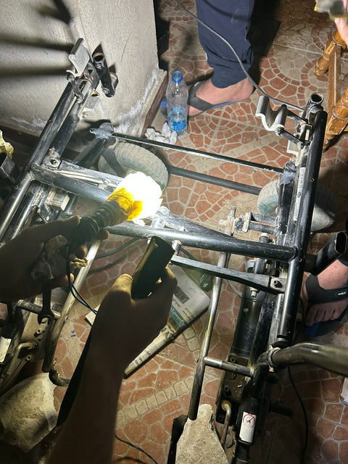
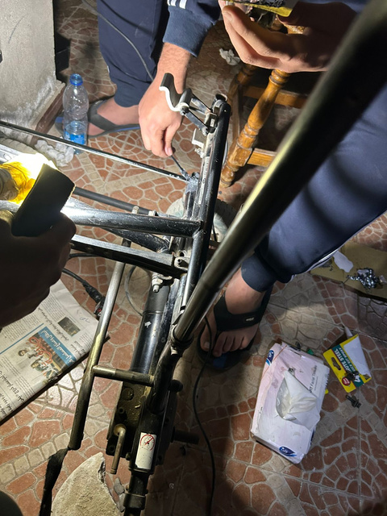
MECHANICAL CHALLENGES
Challenges in movement and balance.
Quick system responsiveness.
Integration with other systems.
11

Slide 12
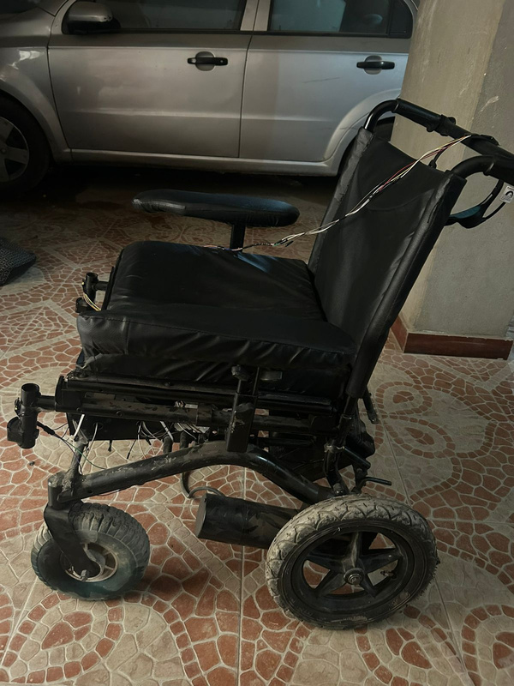
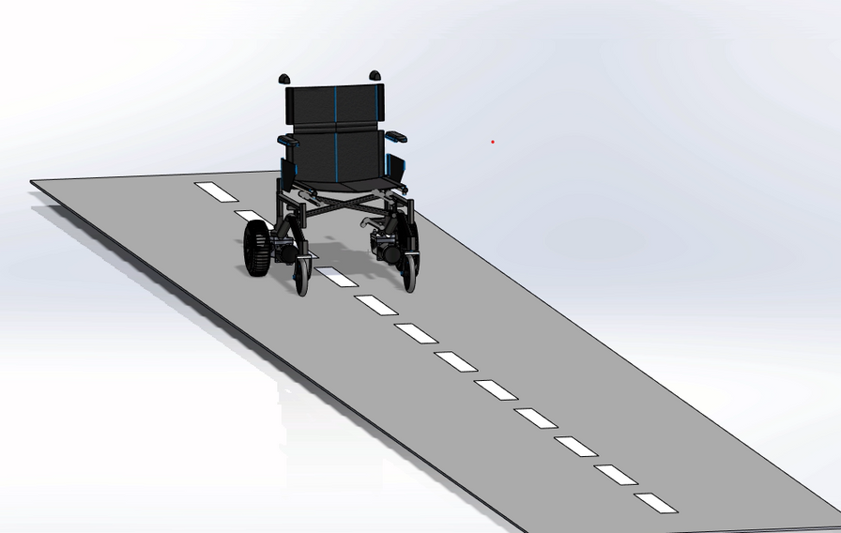
SIMULATION TO REAL-WORLD APPLICATION
"Here, we will show a video demonstrating how we used SolidWorks to simulate the wheelchair’s movement, followed by its application in the real-world prototype."
12

Slide 13
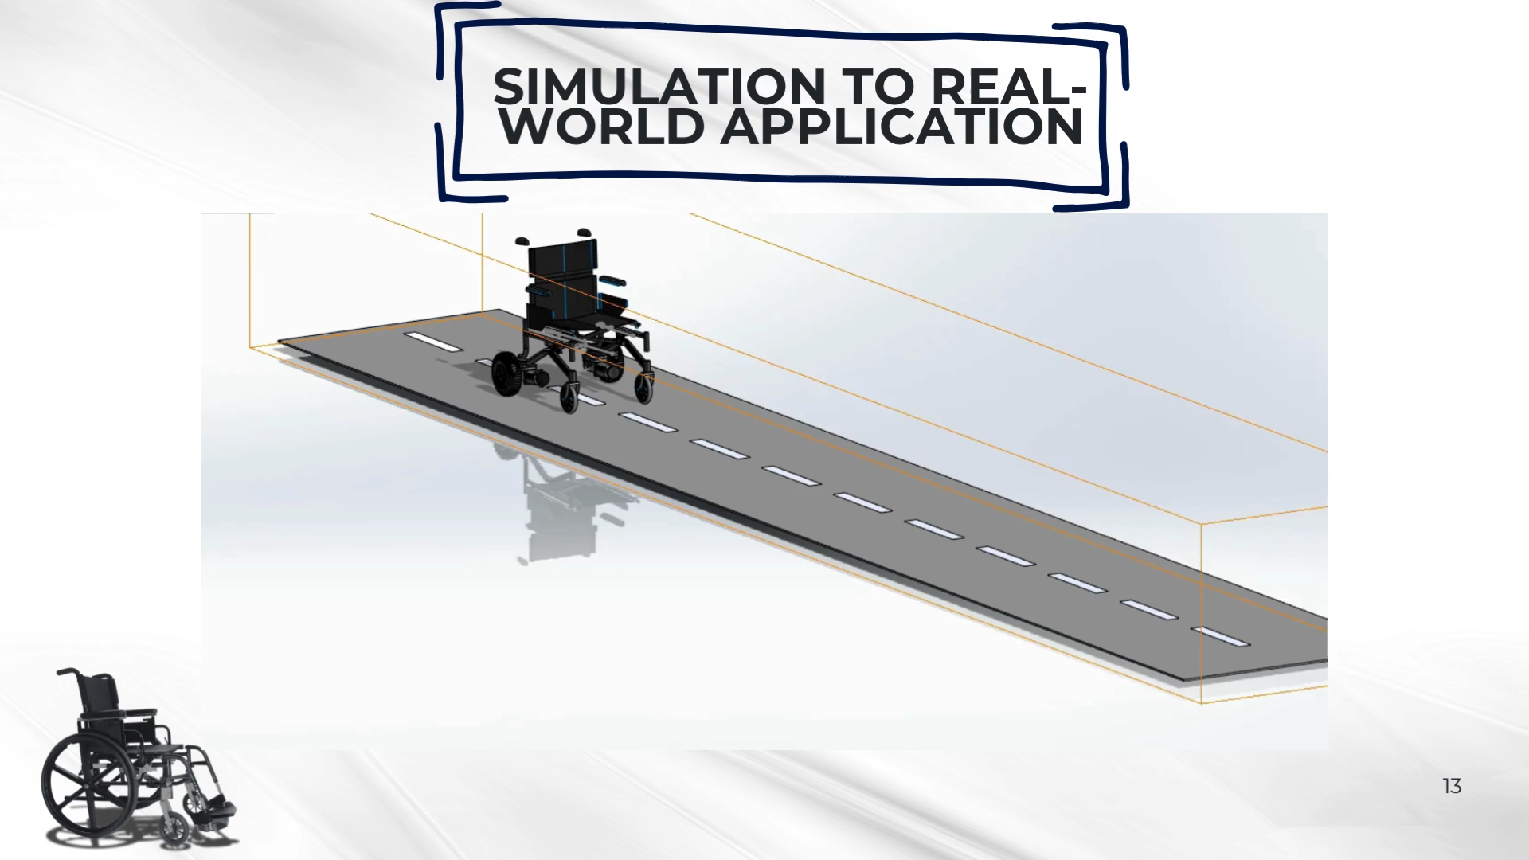
SIMULATION TO REAL-WORLD APPLICATION
13

Slide 14
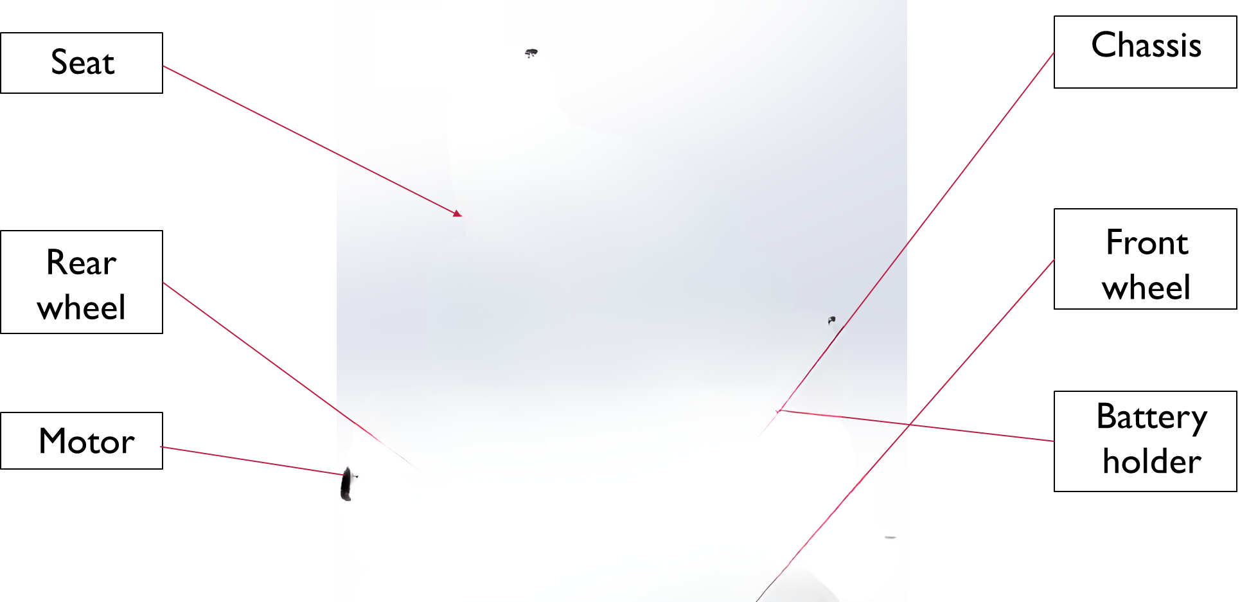
MECHANICAL COMPONENTS AND DESIGN OVERVIEW
14

Slide 15

STRUCTURAL DESIGN
Key design considerations for strength and stability.
Focus on weight distribution and balance.
Use of lightweight but strong materials.
15

Slide 16
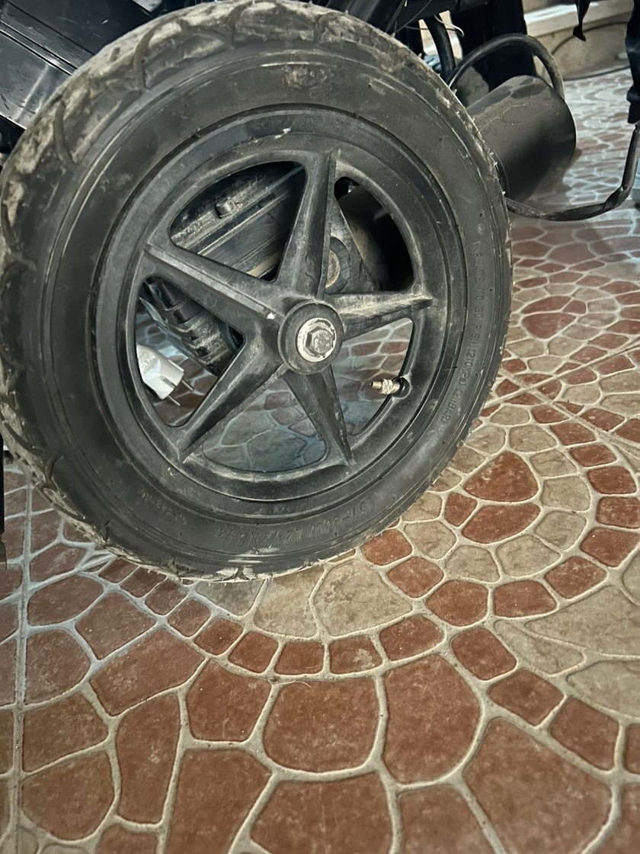
WHEELS DESIGN AND FUNCTIONALITY
Type and size of wheels used.
Role in maneuverability and surface compatibility.
Design decisions to ensure stability and comfort.
16

Slide 17
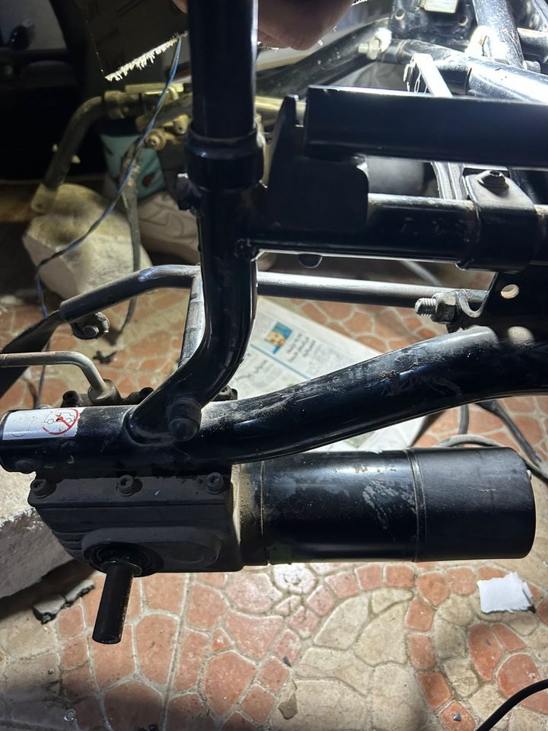
MOTORS AND ACTUATORS
Type of motors used.
Importance in movement and responsiveness.
Integration with control system for brainwave interaction.
17

Slide 18
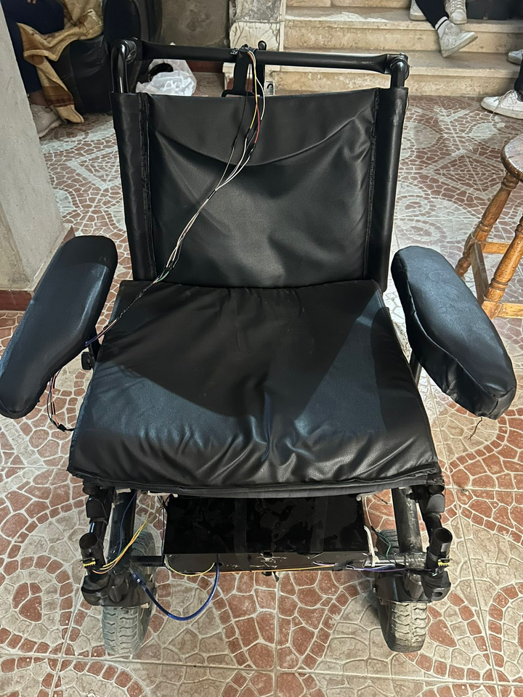
Seat Comfort and Design
Leather with a large foam layer for comfort.
Pressure relief and better support.
Ergonomic design for comfort and support.
18

Slide 19
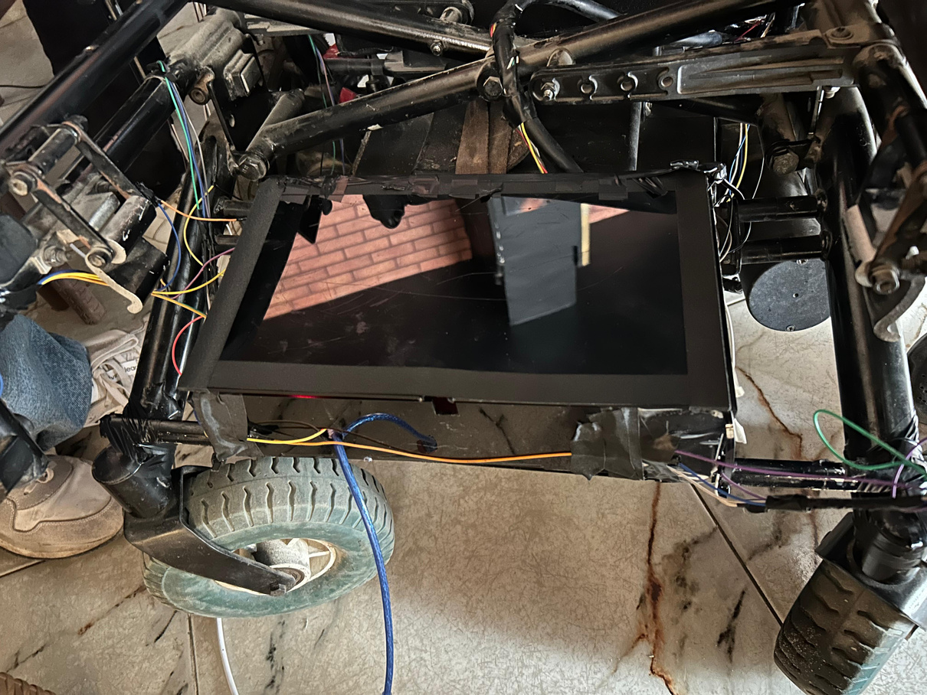
Control Box
Custom acrylic box for controller and motor driver.
Positioned above the front wheel and below the seat.
Transparent for easy access and maintenance.
19

Slide 20
Material
properties
Cast carbon steel was selected for the wheelchair frame due to its exceptional properties
Properties | value
Yield strength: | 2.48168e+08 N/m^2
Tensile strength: | 4.82549e+08N/m^2
Elastic modulus: | 2e+11N/m^2
Poisson's ratio: | 0.32
Mass density: | 7,800kg/m^3
Shear modulus: | 7.6e+10N/m^2
Therma expansion coefficient: | 1.2e-05/Kelvin
20

Slide 21
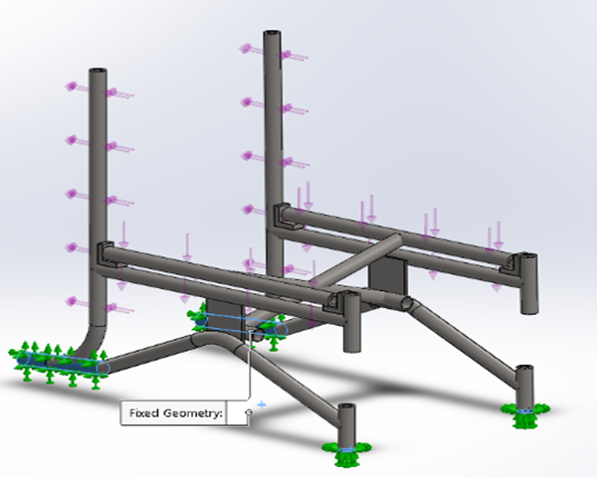
STRUCTURE
ANALYSIS
After selecting cast carbon steel, a structural analysis was conducted to evaluate the design's ability to withstand loads and meet safety standards.
Fixtures
Four fixed-geometry fixtures were used in the study: two supporting the front castor wheels and two for the rear wheel axles.
21

Slide 22
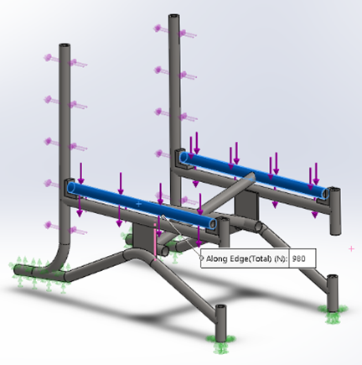
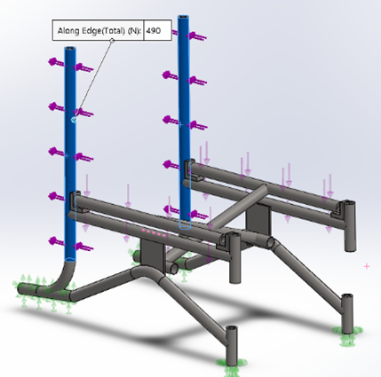
Loads
A simulated load of 100 kg was applied, distributing approximately 980 N to the seat and 490 N to the backrest.
This allows us to evaluate how the chair performs under realistic conditions
22

Slide 23
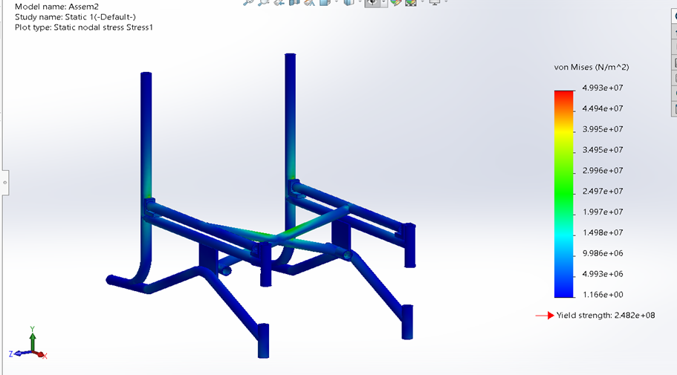
STUDY
RESULTS
Boundary conditions applied; results plotted for analysis.
Stress
The maximum observed stress was 4.993 × 10⁷ N/m², which is well within the yield strength limit, confirming the design's structural safety.
23

Slide 24
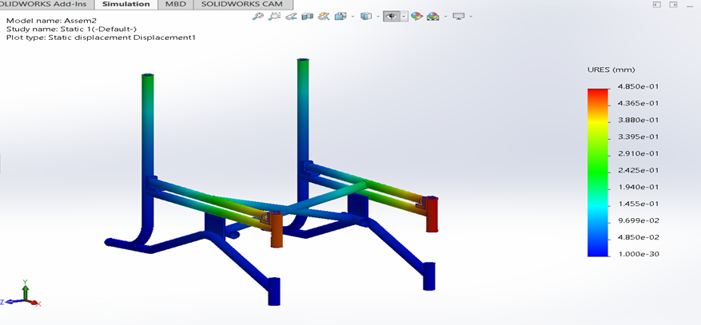
Displacement
Displacements below 0.485 mm are considered within the safe limit.
24

Slide 25
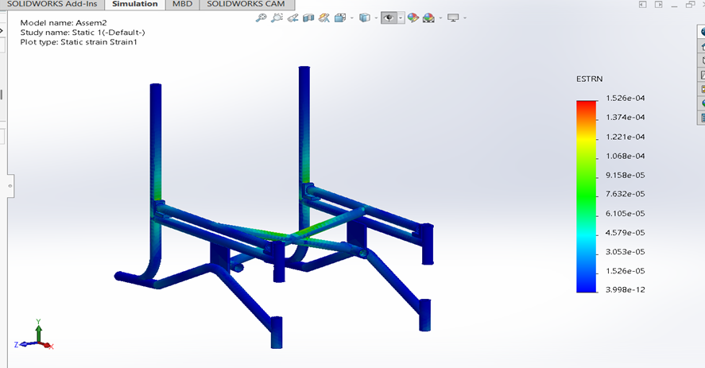
Strain
A maximum strain of 1.526 × 10⁻⁴ is permissible for safe operation.
25

Slide 26
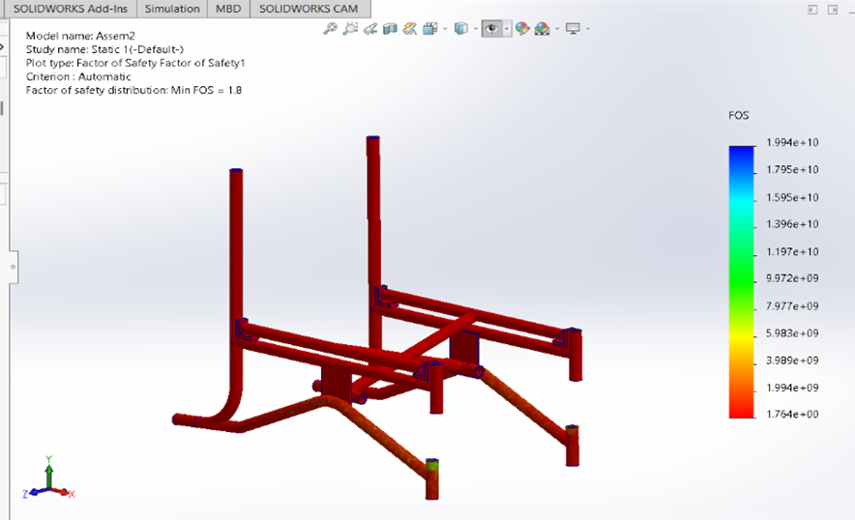
Factor Of Safety
The design is considered safe as long as the factor of safety exceeds the minimum value of 1.764.
26

Slide 27


THE MAIN COMPONENTS OF ELECTRICAL SYSTEM
Actuators
power
Controllers
Sensors
Neurosky EEG Sensor
Gyroscope sensor
Time of flight sensor
EasyEDA simulation
27

Slide 28
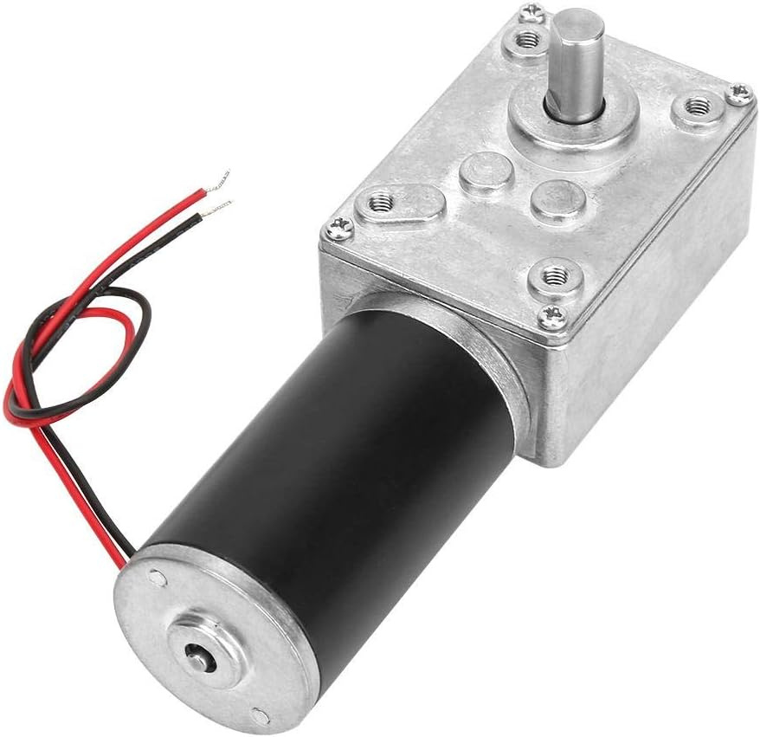
COMPONENTS
1- Actuators (DC Brushed Motors)
Function: Generate the power to rotate the wheelchair in various directions.
Specifications :
Quantity: 2 motors
Power: 110 Watts per motor
Voltage: 24 Volts
28

Slide 29
COMPONENTS
1- Actuators (DC Brushed Motors)
Advantages :
Readily available
Cost-effective
Simple construction
Controller is easy and affordable
29

Slide 30

COMPONENTS
2- POWER SUPPLY
- Batteries:
Type: Gel/AGM lead-acid batteries
Voltage: 12 Volts per battery
Capacity: 30 Ampere-hour per battery
Connection: Series connection (to provide 24 Volts)
30

Slide 31
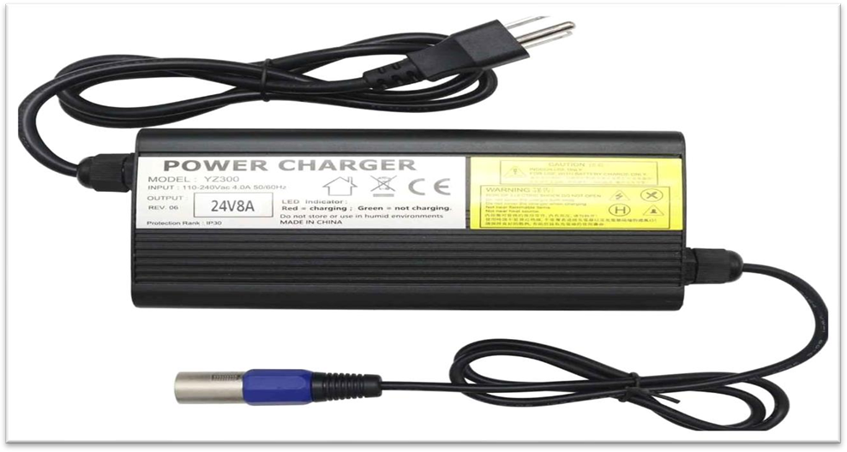
COMPONENTS
2- POWER SUPPLY
- POWER CHARGER :
Current : 8 Amperes
Voltage : 24 volt
Function : Safely and efficiently charges the batteries
31

Slide 32


COMPONENTS
3- CONTROLLERS
MICROCONTROLLERS
MOTOR DRIVE
32

Slide 33
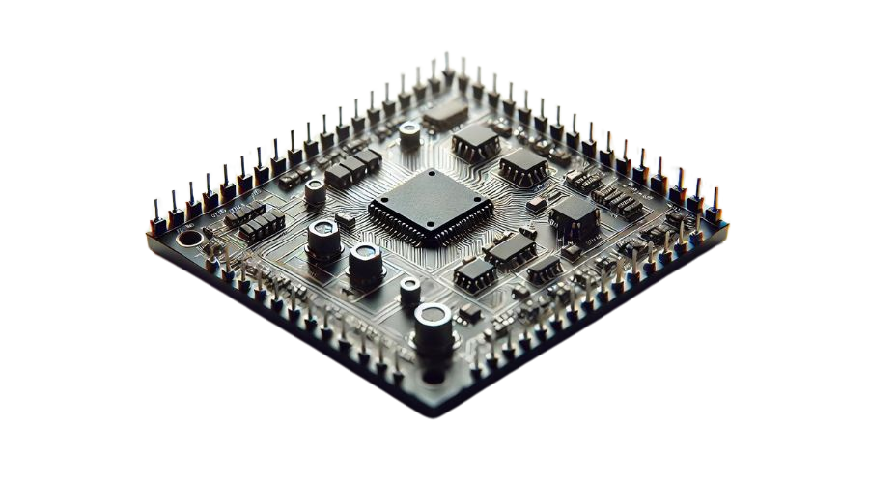
COMPONENTS
3- CONTROLLERS
MICROCONTROLLERS
A microcontroller is a compact, integrated circuit designed to govern a specific operation in an embedded system.
33

Slide 34
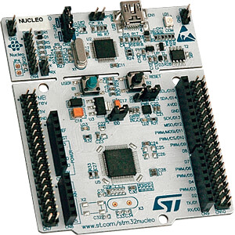
COMPONENTS
MICROCONTROLLERS
STM32 NUCLEO F446RE FEATURES :
MCU: STM32F446RE
Core: ARM Cortex-M4 (32-bit) with Floating Point Unit (FPU)
Clock Speed: Up to 180 MHz
Flash Memory: 512 KB
SRAM: 128 KB
.
34

Slide 35
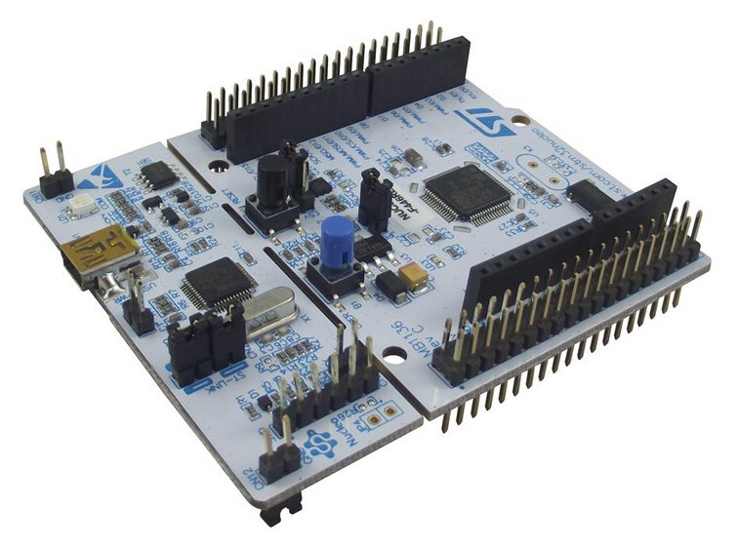
COMPONENTS
MICROCONTROLLERS
An affordable and flexible solution for testing concepts and building prototypes, offering a balance of performance and power efficiency.
Role in the wheelchair:
EEG data processing from Neurosky.
Motor control for the wheelchair.
Sensors for obstacle detection and ADAS
STM32 NUCLEO F446RE
35

Slide 36
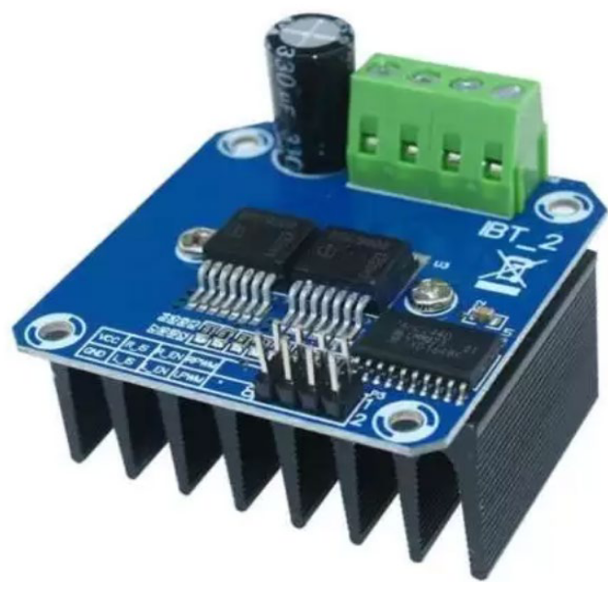
COMPONENTS
MOTOR DRIVE ( BTS7960 )
OVERVIEW:
The BTS7960 43A motor driver module is a powerful and reliable choice for controlling high-current DC motors in various embedded and automation systems.
36

Slide 37
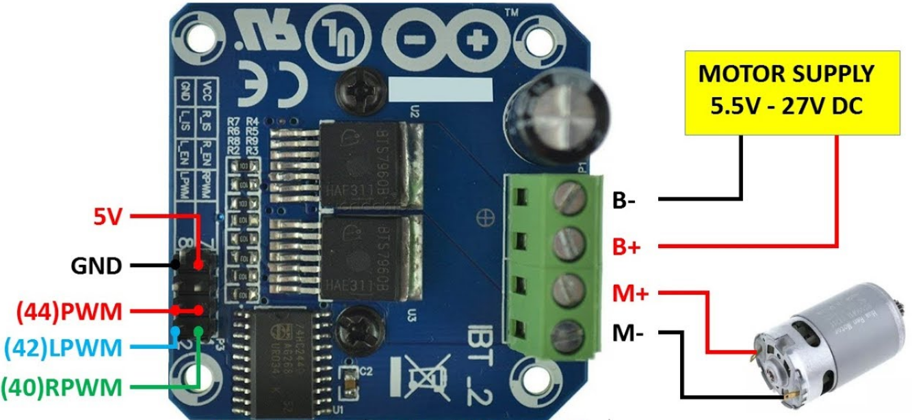
COMPONENTS
MOTOR DRIVE ( BTS7960 )
FEATURES :
Supports up to 43A continuous current
Operating voltage: 5.5V to 27V
Full speed & direction control via PWM
Dual H-Bridge for efficient control
Built-in protections:
Over-temperature
Over-current
Short-circuit
37

Slide 38
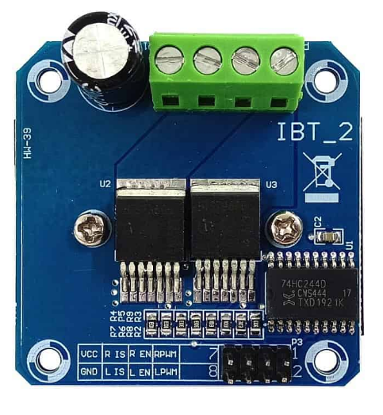
COMPONENTS
MOTOR DRIVE ( BTS7960 )
Role in the wheelchair:
Enables safe and smooth motion of the wheelchair.
Provides reliable, high-power control.
Essential for mobility and precision in electric wheelchair systems
38

Slide 39
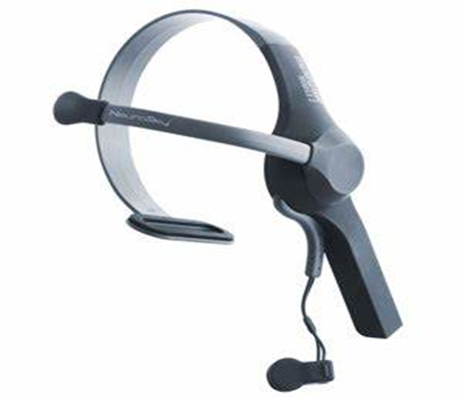
SENSORS
EEG Sensor for Forward and Backward Motion
Neurosky EEG Sensor
Blink Detection : Strength and frequency of blinks trigger forward and backward movement.
Brain-Computer Interface (BCI) : Detects brain activity non-invasively for natural control.
39

Slide 40
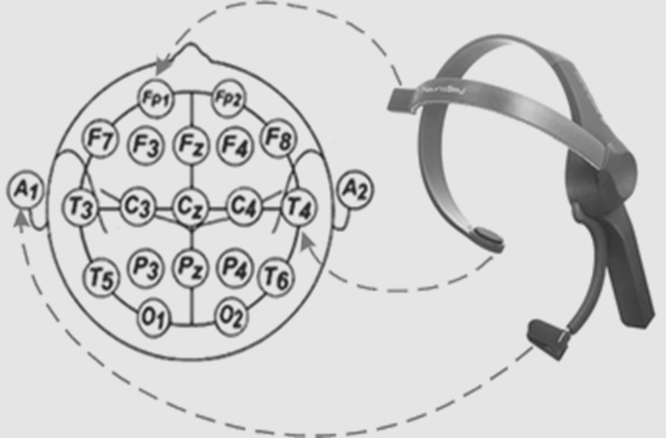
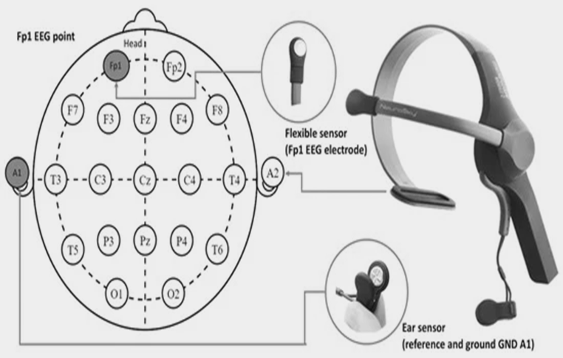
Sensor Detecting signal
40

Slide 41
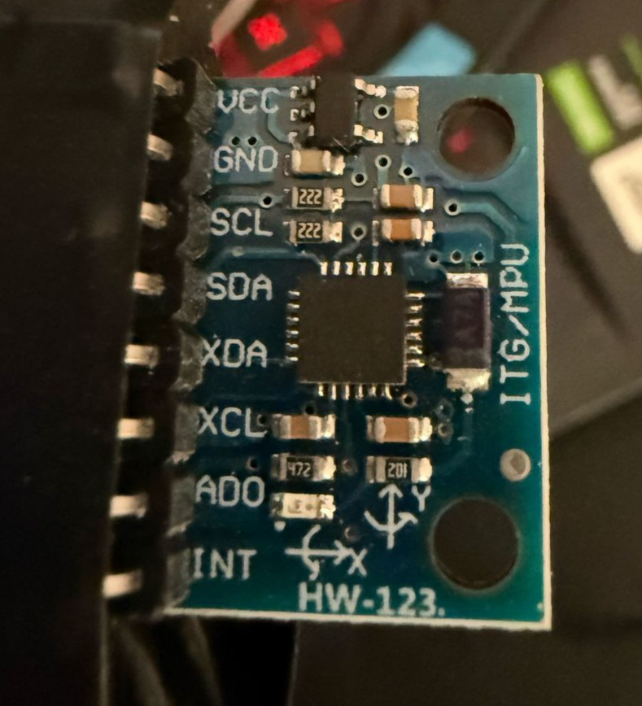
HEAD MOVEMENT FOR DIRECTIONAL CONTROL
GYROSCOPE SENSOR:
TYPE USED : MPU6050
Head Tilt Left : Wheelchair moves left when head tilts beyond set angle.
Head Tilt Right : Wheelchair moves right with corresponding tilt detection.
MEMS 3-aixs accelerometer and 3-axis gyroscope values combined
41

Slide 42
HEAD MOVEMENT FOR DIRECTIONAL CONTROL
Accelerometer Only
Can detect tilt and orientation but is noisy during movement
Gyroscope Only
Detects rotation only, cannot detect tilt or gravity
Both Together (IMU)
Combines both to give stable, precise orientation and motion tracking
42

Slide 43
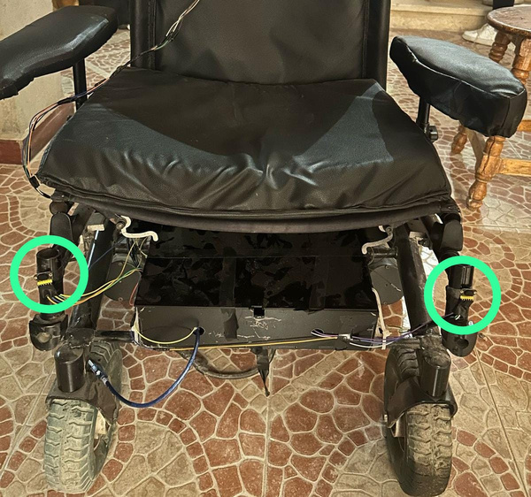
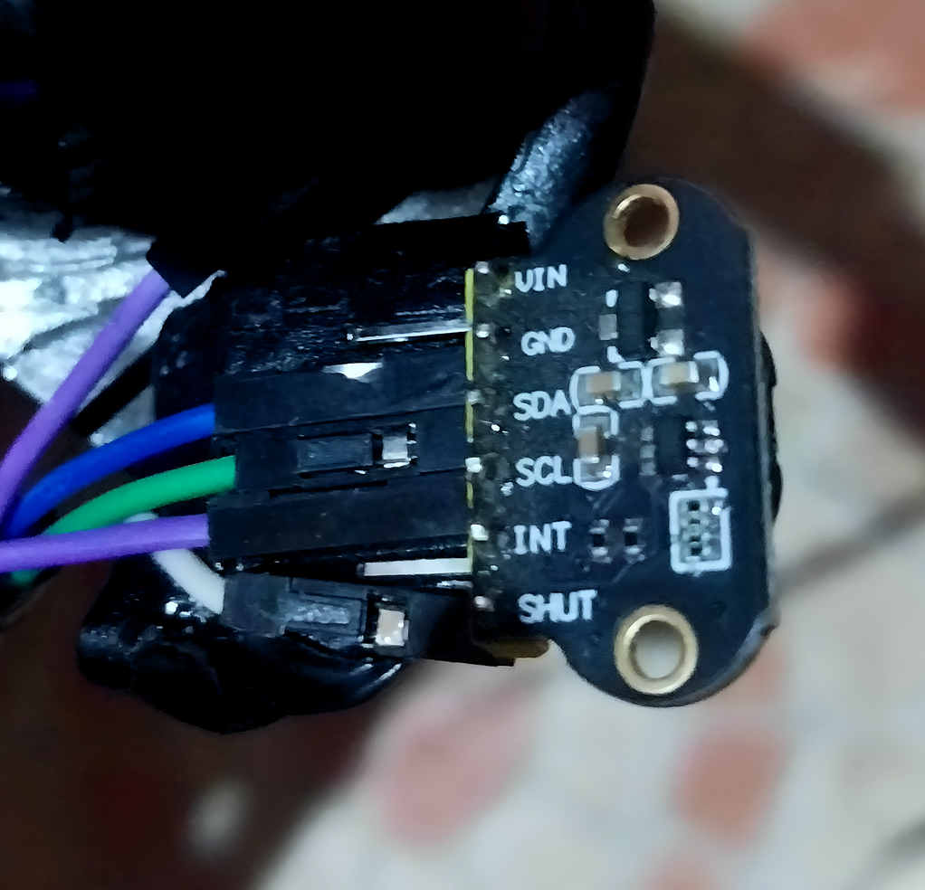
ADVANCED OBSTACLE DETECTION
TYPE USED : TOF400C-VL53L1X
Four ToF Sensors : Placed at all corners for 360-degree obstacle detection.
measures the distance to an object by emitting infrared light
Automatic Safety Response : Sensors trigger automatic stop when obstacles are detected.
43

Slide 44
Advantages of ToF Sensors vs. Ultrasonic Sensors
Precision
ToF sensors provide more accurate distance measurements.
Faster Response
as it is Light-based sensing
They offer quicker obstacle detection for safer navigation.
Robustness
Less affected by environmental noise compared to ultrasonic sensors
Smaller Size
Compact design fits easily on all wheelchair corners.
44

Slide 45
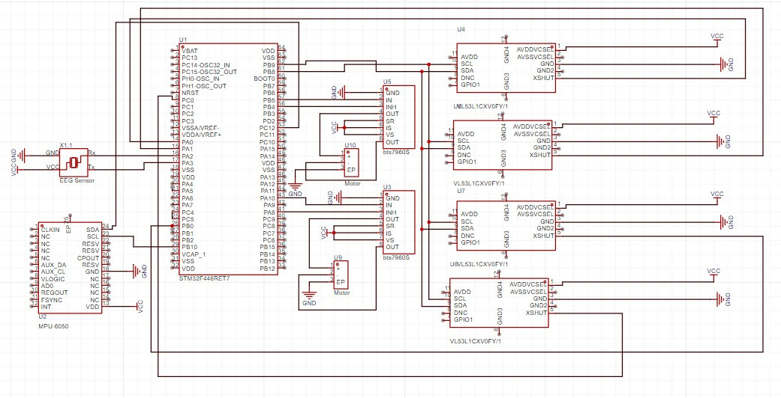
EasyEDA simulation
components:
four time of flight sensor
two motor drivers
two motors
microcontroller STM32
EEG Sensor
Gyroscope sensor
45

Slide 46
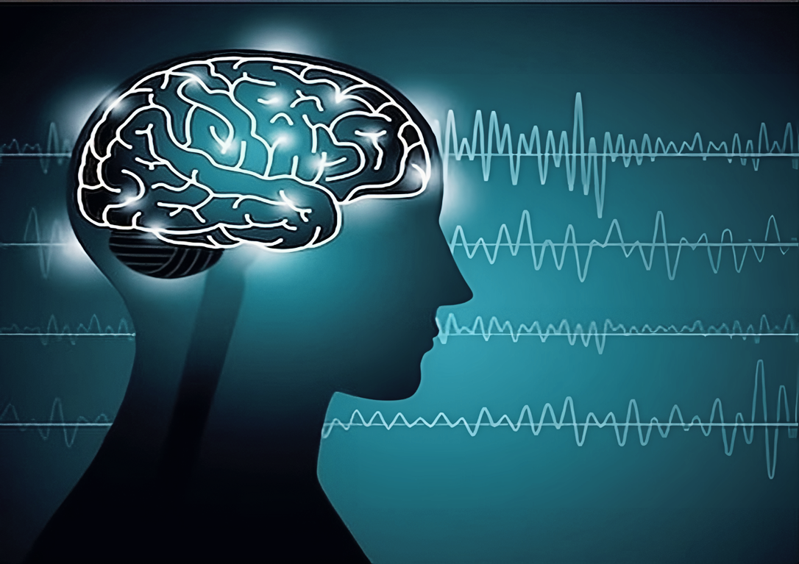
PROGRAMMING AND the
Brain-Controlled Interface
Overview
Signal Processing and Feature Extraction
Wheel Chair Control System
46

Slide 47
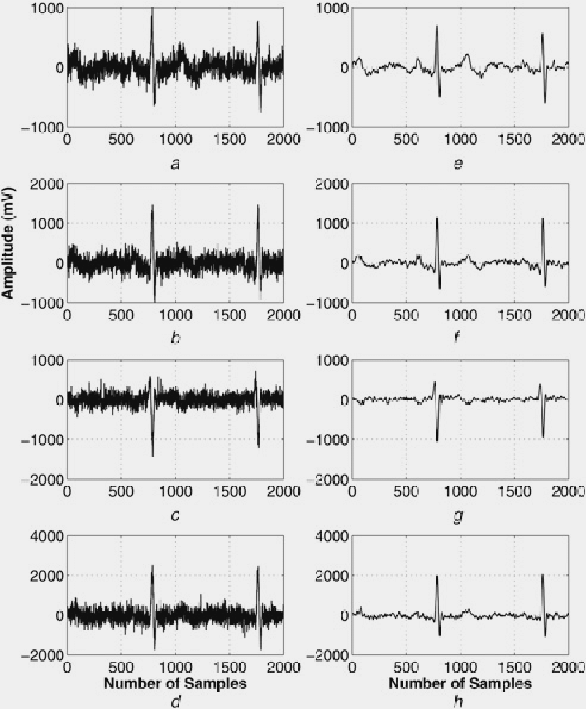
Signal Processing and Feature Extraction
• Noise filtering and signal enhancement.
There are several types of Noise filtering:
- Notch Filtering
- smoothing
- Band-PassFiltering
47

Slide 48
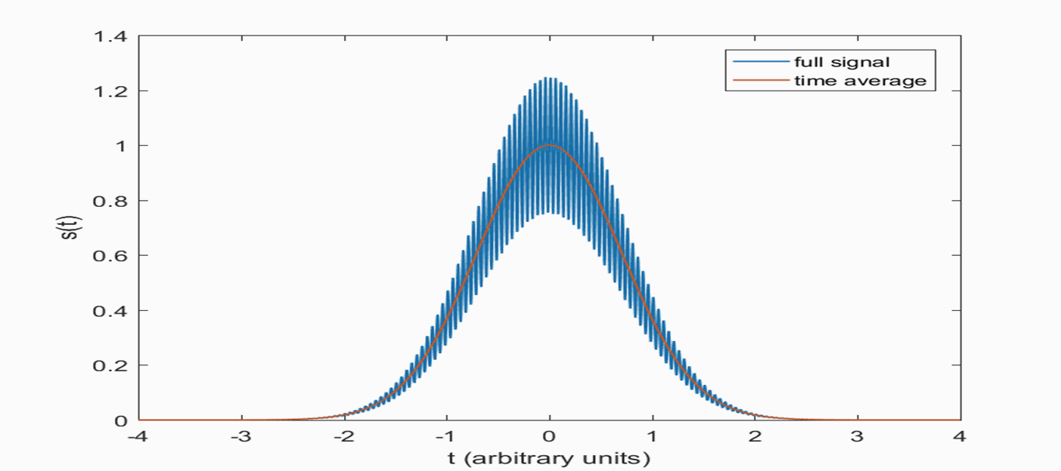
Signal Processing and Feature Extraction
There are several types of Noise filtering.
- Notch Filtering
48

Slide 49
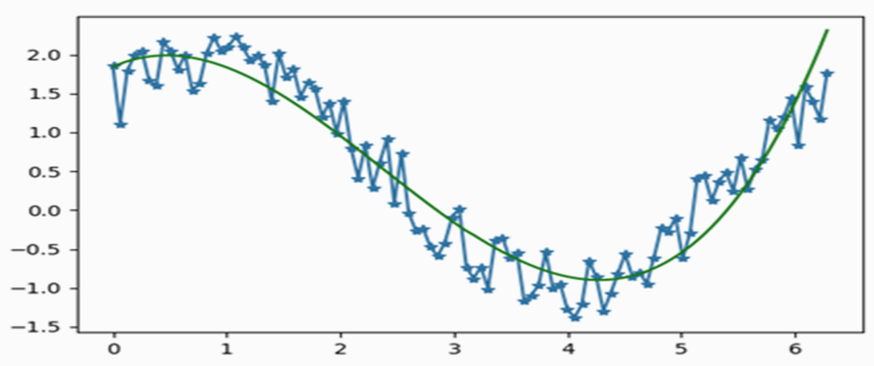
Signal Processing and Feature Extraction
There are several types of Noise filtering.
- SMOOTHING
49

Slide 50

Signal Processing and Feature Extraction
There are several types of Noise filtering.
- Band-PassFiltering
50

Slide 51

Signal Processing and Feature Extraction
Extracting key features like EEG patterns or specific brainwave frequencies.
51

Slide 52

Wheel Chair Control System
•This diagram illustrates the process of acquiring, processing, and classifying EEG signals to generate commands for controlling the brain-controlled wheelchair.
52

Slide 53

Wheel Chair Control System
The control system uses brainwave data (blink & attention) or head tilt detected by a gyroscope to control a wheelchair.
Blinks trigger forward, backward, and stop commands
Attention levels control left, right, and stop actions
Head tilt via gyroscope allows intuitive left/right navigation as a second mode
Integrated with an ADAS (Advanced Driver Assistance System) to enhance safety and autonomy.
53

Slide 54

Wheel Chair Control System
EEG Control – Blink Commands
Blink strength is mapped to forward, backward counts, and specific blink patterns trigger movement commands like 'F' (Forward), 'B' (Backward), or 'S' (Stop).
54

Slide 55

Wheel Chair Control System
Brainwave Control – Attention Levels
Depending on attention level, the system sends 'R' (Right), 'L' (Left), or 'S' (Stop); low attention stops the system entirely.
55

Slide 56

Wheel Chair Control System
Gyroscope-Based Head Tilt Control
Uses gyroscope to detect head tilt direction
Intuitive directional control:
• Tilt left: Turn left
• Tilt right: Turn right
Alternative to brainwave control; supports user flexibility
56

Slide 57

Wheel Chair Control System
Advanced Driver Assistance System (ADAS)
ADAS – Obstacle Avoidance with ToF Technology
Integrated Time-of-Flight (ToF) sensor for distance measurement
Continuously monitors space in front of the wheelchair
Safe Distance Threshold: > 50 cm
If distance ≤ 50 cm, the wheelchair automatically stops
Ensures real-time collision prevention in crowded or dynamic areas
57

Slide 58
Wheel Chair Control System
Safety Features Overview
Comprehensive Safety Measures in Wheelchair Control System
Time-of-Flight Sensor (ADAS):
• Continuously monitors for obstacles
• Automatically stops if object is ≤ 50 cm away
Controlled Motor Commands via STM32:
• Prevents sudden or unintended movements
• Only responds to valid, recognized signals
Dual Control Modes:
• Allows fallback if one mode fails (Brainwave ↔ Gyroscope)
Hands-Free Operation:
• Reduces user fatigue and risk of control errors
58

Slide 59

CONTROL PROCESS
The electrical and control system is the backbone of the project, responsible for interpreting neural signals and converting them into precise motor actions.
59

Slide 60

MIND TO MOTION: SMART EEG WHEELCHAIR WITH REAL-TIME SAFETY
60

Slide 61


MIND TO MOTION: SMART EEG WHEELCHAIR WITH REAL-TIME SAFETY
Step 1 - Signal Acquisition
Objective: Capture real-time brain activity.
Device: MindWave Mobile 2 EEG sensor.
Signal Types: Attention, Meditation, and Blink strength.
Connection: Bluetooth to Python-based PC/server.
61

Slide 62


MIND TO MOTION: SMART EEG WHEELCHAIR WITH REAL-TIME SAFETY
Step 2 - Signal Processing
Convert raw EEG signals into usable control commands.
Language: Python.
Method: Parsing and filtering data using json format.
Filtering: Data cleaning and validation (blink strength, attention thresholds).
Output: Clean values forwarded for decision-making.
62

Slide 63
MIND TO MOTION: SMART EEG WHEELCHAIR WITH REAL-TIME SAFETY
63

Slide 64

MIND TO MOTION: SMART EEG WHEELCHAIR WITH REAL-TIME SAFETY
Step 3 - Decision Making
Objective: Translate brain signal values into movement commands.
Device: STM32 Microcontroller.
Logic:
Blink → Move Forward.
High Blink → Stop or Move Backward.
Gyroscope → Turn Left/Right.
64

Slide 65

MIND TO MOTION: SMART EEG WHEELCHAIR WITH REAL-TIME SAFETY
Step 4 - Motor Actuation
Objective: Physically move the wheelchair.
Components: Dual Motor Drivers.
Commands: Received via UART from STM32.
Control: Smooth start, stop, and direction change based on brain signals.
66

Slide 66

MIND TO MOTION: SMART EEG WHEELCHAIR WITH REAL-TIME SAFETY
Step 5 - Safety and Feedback
Objective: Maintain safe and stable operation.
Sensors: 4 TOF Distance Sensors and 1 MPU6050 Gyroscope.
Functions:
Obstacle Detection (front/back/side).
Fall and Tilt Detection via Gyroscope.
Response: Auto-stop or rerouting if unsafe conditions are detected.
67

Slide 67
MIND TO MOTION: SMART EEG WHEELCHAIR WITH REAL-TIME SAFETY
68

Slide 68
Testing
from mind to motion
69

Slide 69


CONCLUSION

Slide 70

CONCLUSION
The project demonstrates a significant leap forward in assistive technology, offering people with severe motor disabilities a real, hands-free mobility solution
With successful testing of EEG signal translation, obstacle avoidance, and user comfort, the wheelchair is both functional and scalable.
73

Slide 71

74

Slide 72

FUTURE WORK
Healthcare Sensors Integration: We aim to incorporate health-monitoring sensors such as heart rate monitors, body temperature sensors, and pulse oximeters. These will help in detecting fatigue, stress, or medical emergencies while using the chair.
75

Slide 73

FUTURE WORK
GPS Navigation System: The future model will feature GPS modules for real-time location tracking and auto-routing, enabling autonomous indoor and outdoor navigation.
76

Slide 74

FUTURE WORK
Mobile App Connectivity:
A dedicated app will be developed to allow remote monitoring, caregiver alerts, and control features through smartphones.
77

Slide 75

FUTURE WORK
Artificial Intelligence (AI) Integration: Machine learning models will be trained on user behavior to adapt the chair’s response, personalize performance, and reduce false triggers.
78

Slide 76
REFERENCE
1. Niedermeyer, E., & da Silva, F. L. (2004). Electroencephalography: Basic
Principles, Clinical Applications, and Related Fields (5th ed.). Lippincott
Williams & Wilkins.
https://www.wolterskluwer.com/en/solutions/ovid/niedermeyers?electroencephalography-basic-principles-clinical-applications-and-related?fields-8611
2. Lebedev, M. A., & Nicolelis, M. A. L. (2006). Brain–machine interfaces: Past,
present and future. Trends in Neurosciences, 29(9), 536-546.
https://pubmed.ncbi.nlm.nih.gov/16859758/
3. He, H., Wu, D., & Li, Y. (2016). A brain-controlled wheelchair system for
disabled people. IEEE Transactions on Biomedical Engineering, 63(10), 2302–
2311.
https://www.researchgate.net/publication/224137450_A_Brain_Controlled_Wh
eelchair_to_Navigate_in_Familiar_Environments
79

Slide 77
REFERENCE
4. Zhu, X., Zhang, S., & Zhang, D. (2015). A brain-controlled wheelchair using
EEG signals. IEEE Access, 3, 1696-1704.
https://pmc.ncbi.nlm.nih.gov/articles/PMC8473300/
5. Liu, Y., Sourina, O., & Tan, J. (2008). Real-time EEG neurofeedback for brain–
computer interface. Proceedings of the International Conference on Computer
Graphics and Digital Imaging, 1-4. https://journalofethics.ama?assn.org/article/ethical-and-social-challenges-brain-computer-interfaces/2007-
6. Zhang, Y., & Wang, J. (2014). A novel EEG-based brain-computer interface
design for wheelchair control. Journal of Neural Engineering, 11(4), 046002.
https://www.worldscientific.com/doi/abs/10.1142/S0129065714500142?srsltid
=AfmBOorGV4X20sAvhYxQWiollM5wKrsbAhp9WyZUXwIE7h96dszepvrv
80

Slide 78
Thank You
fOR YOUR ATTENTION
81

